Slide 1
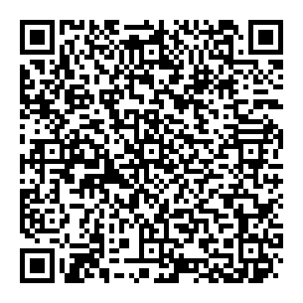
Tweets sentiments analysis and classification with NLP - Machine Learning
Dylan Montoya
Biomedical engineer, data scientist
Contact me
Meetup Medellín - NLP

Slide 2
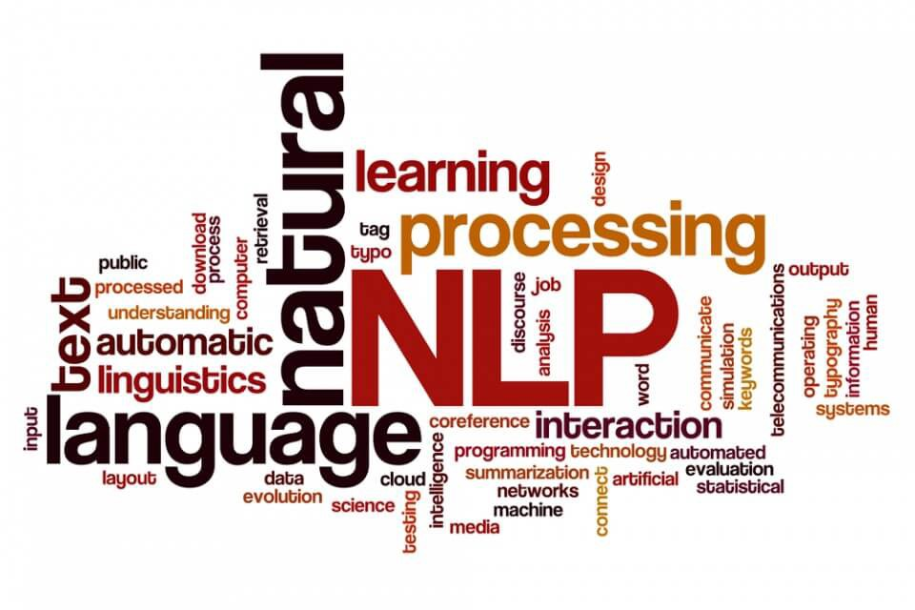
Natural Language Processing
Refers to the branch of computer science and more specifically, the branch of AI.
NLP task: Speech recognition, Sentiment analysis, Named entity recognition, so on.
Use cases: Machine translation, virtual agents and chatbots, text summarization, among others.

Slide 3
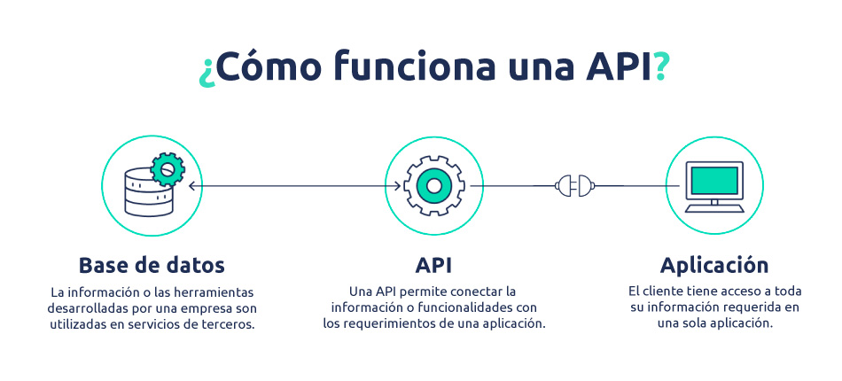
Twitter API

Slide 4
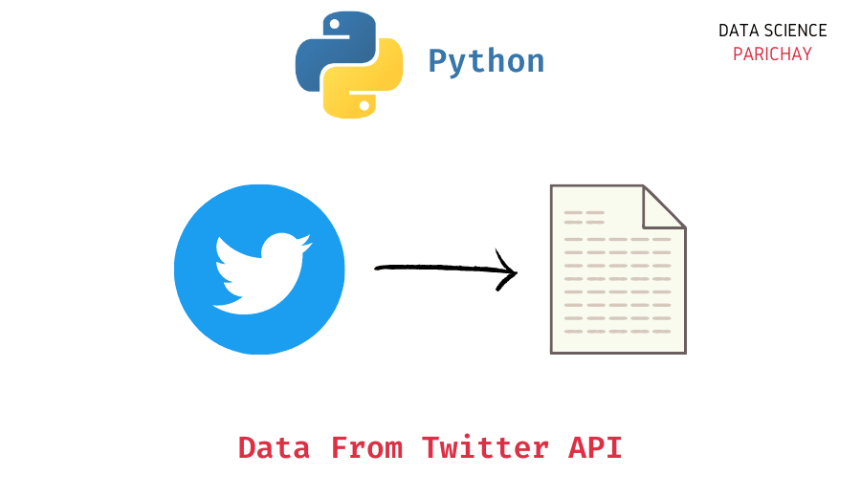
Limitations
180 requests each 15 minutes.
TWEETS SEARCH: 450 tweets per request.
USERS: 900 users per request.
TIMELINES: 1500 tweets per request. (Last 3200 tweets and retweets).

Slide 5
Dataset
Compilation of recent tweets about the Pfizer and BioNTech vaccine.
Study the subjects of recent tweets about the vaccine made in collaboration by Pfizer and BioNTech, perform various NLP tasks on this data source.
Conjunto de datos

Slide 6
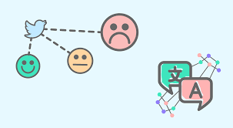
Data preparation
Lower case.
Stemming.
Remove elements such as stopwords, special characters, punctuation, web links, numbers, tokens (hashtags and reference users), multiple blank spaces, non-ascii characters and tickers.
Convert each tweet into its respective vector representation using the bag-of-words approach, CountVectorizer.
Feature extraction.
Data modelling.
Model application

Slide 7
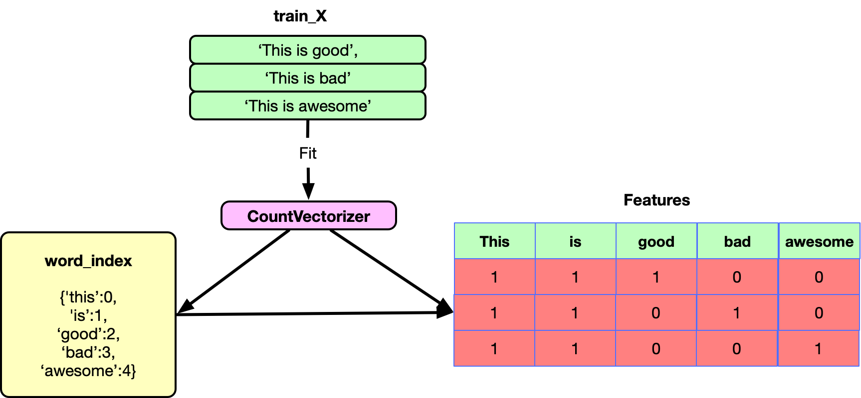
Word embedding
CountVectorizer

Slide 8
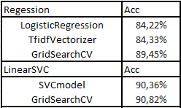
Prediction models

